Slide 1

Coding with TensorFlow in Google Colaboratory
Notes:
‹#›

Slide 2
Objectives
Understand and Using Colab
Coding with TensorFlow in Google Colaboratory
Examples
Coding with TensorFlow in Google Colaboratory
‹#›

Slide 3
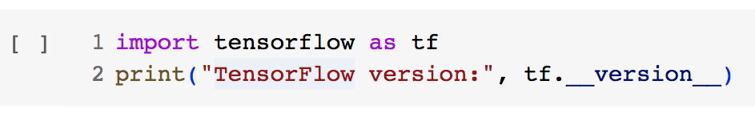
Understand and Using Colab
Colaboratory is a hosted Jupyter notebook environment that is free to use and requires no setup.
TensorFlow is already pre-installed and optimized for the hardware being used. Just import tensorflow as tf, and start coding.
Coding with TensorFlow in Google Colaboratory
‹#›
Notes:
‹#›

Slide 4
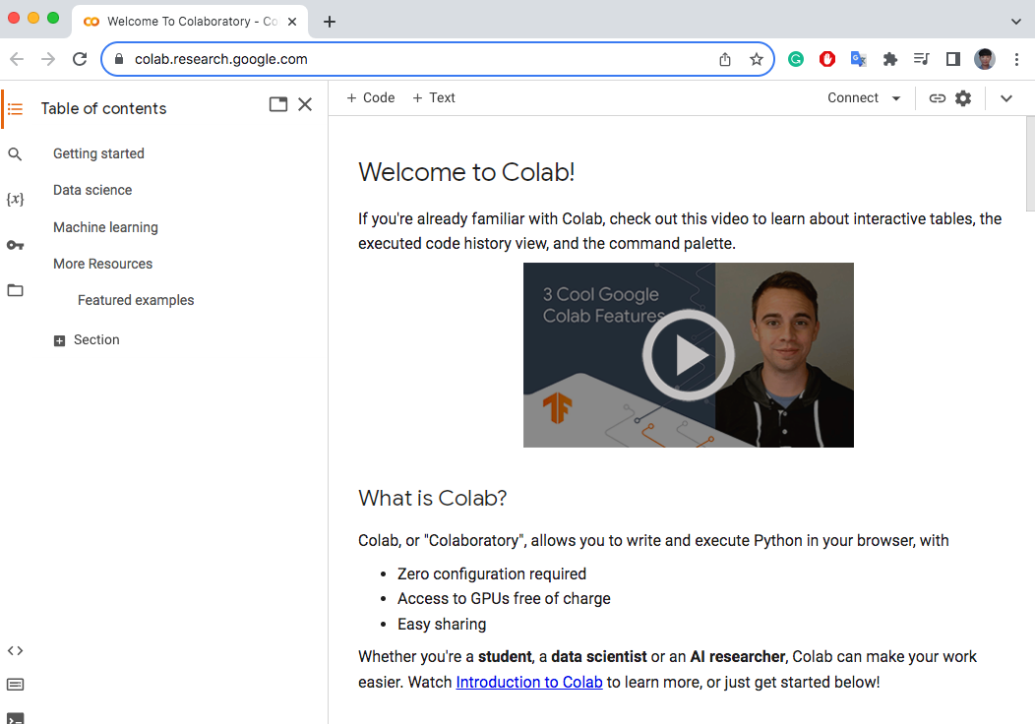
Understand and Using Colab
Set up a basic environment for TensorFlow within Colab:
Open https://colab.research.google.com/ and register for a free account
Coding with TensorFlow in Google Colaboratory
‹#›
Notes:
‹#›

Slide 5
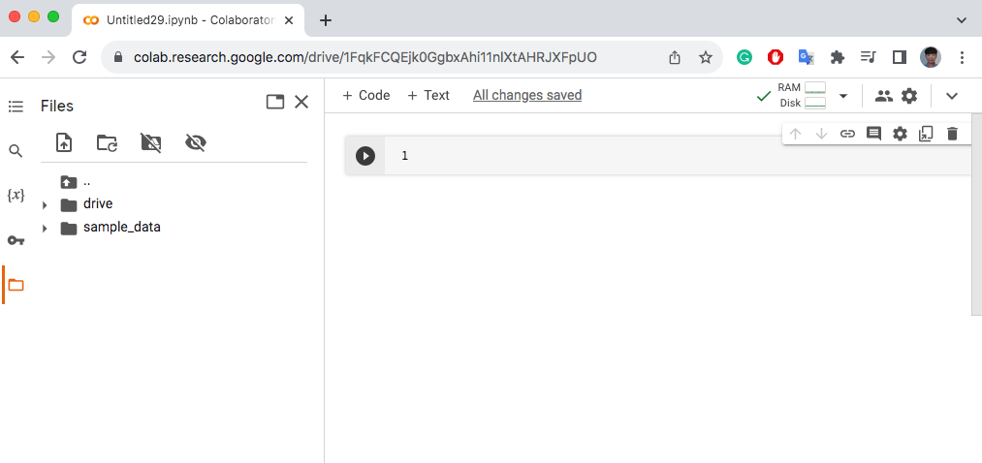
Understand and Using Colab
Create a new notebook within Colab
Coding with TensorFlow in Google Colaboratory
‹#›
Notes:
‹#›

Slide 6
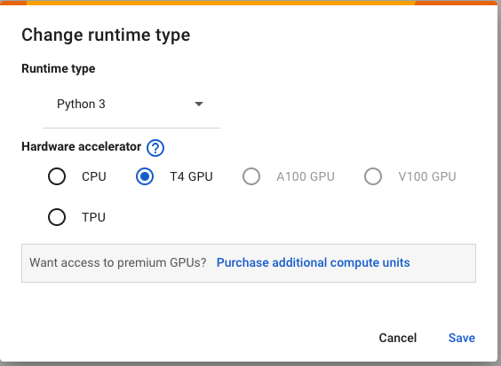
Understand and Using Colab
Select Runtime from the menu and Change the runtime type
Coding with TensorFlow in Google Colaboratory
‹#›
Notes:
‹#›

Slide 7
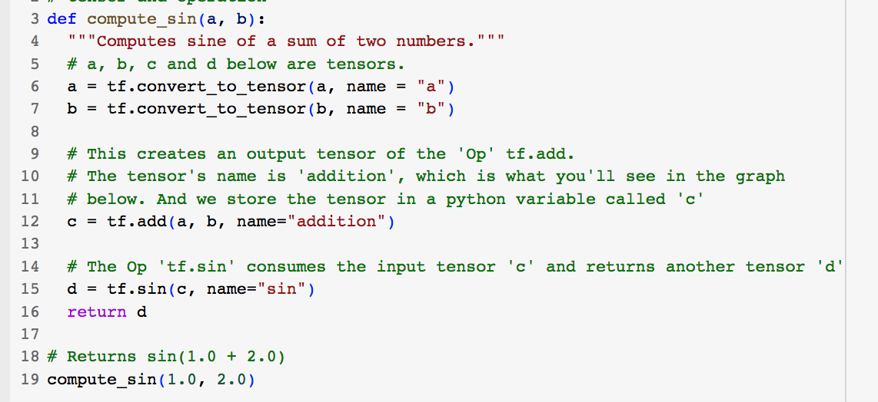
Understand and Using Colab
Example 1: Define a function that returns sin(a + b).
Coding with TensorFlow in Google Colaboratory
‹#›
Notes:
‹#›

Slide 8
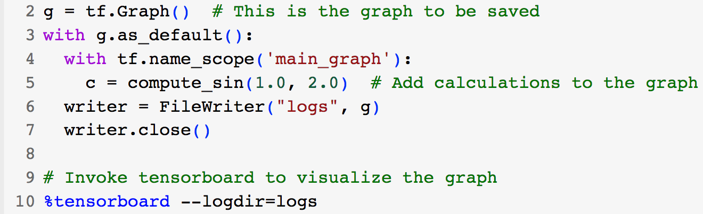
Understand and Using Colab
Example 2: Computation graph visualization
Coding with TensorFlow in Google Colaboratory
‹#›
Notes:
‹#›

Slide 9
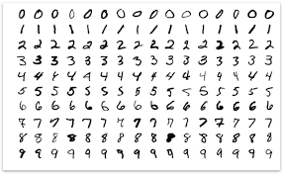
Understand and Using Colab
Classification of Handwritten Digits Using CNN
Dataset: MNIST digits classification
Hidden layer: 2 layers
Activation: relu
Maxpooling
Coding with TensorFlow in Google Colaboratory
‹#›
Notes:
‹#›

Slide 10
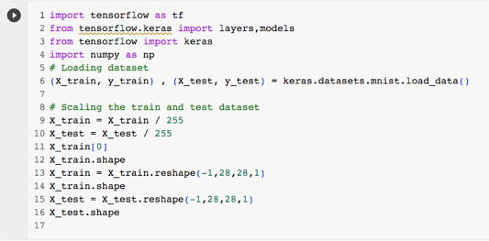
Understand and Using Colab
Coding with TensorFlow in Google Colaboratory
‹#›
Notes:
‹#›

Slide 11
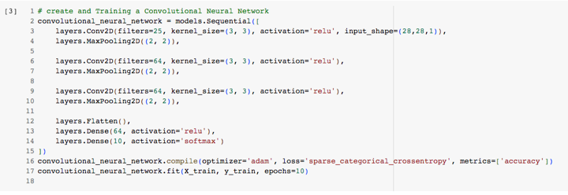
Understand and Using Colab
Coding with TensorFlow in Google Colaboratory
‹#›
Notes:
‹#›

Slide 12
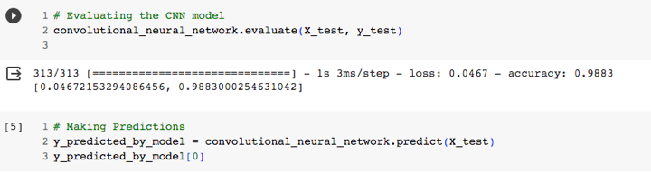
Understand and Using Colab
Accuracy: 0.9883
Coding with TensorFlow in Google Colaboratory
‹#›
Notes:
‹#›

Slide 13
Summary
Understand and Using Colab
Coding with TensorFlow in Google Colaboratory
Examples
Coding with TensorFlow in Google Colaboratory
‹#›

Slide 14
Q & A
Coding with TensorFlow in Google Colaboratory
‹#›

